Slide 1


Ecom Behavioral AWS Infrastructure
Tracking and Analyzing Online Shop User Behavior
By: Shweta Shivamogga Dattatri
23.08.2023
Reference Link: User behavior data pipeline

Slide 2
Introduction
Challenges
Understanding user behavior is paramount
Digital age transforms shopping into an experience.
Online user interactions: A goldmine of insights.
Every click, hover, scroll tells a story.
Decoding interactions:
Boost sales vs. abandoned carts.
Loyal customers vs. one-time visitors.

Slide 3

Project Objective
Real-time Data Capture
Embedded JavaScript in online shops
Capture clicks, cart actions, purchases
Efficient Data Transfer
Use API Gateway to Lambda
Goal: Validate and prepare data
Robust Data Storage & Streaming
Leverage Amazon Kinesis
Ensure data integrity in Amazon S3
In-depth Analysis & Insights
Use AWS Glue for ETL
Derive insights with Athena, Redshift, SageMaker
Visualization & Reporting
Convert data into visual reports
Use QuickSight for stakeholder decisions

Slide 4
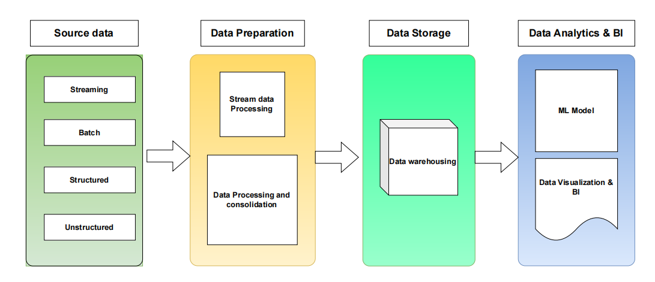
Solution Overview
High-level flowchart or diagram depicting the process
From user interaction to data analysis
Highlight main components
JavaScript tracking
API Gateway
Lambda
Kinesis
S3
AWS Glue
Reference link: Datapipeline block diagram

Slide 5
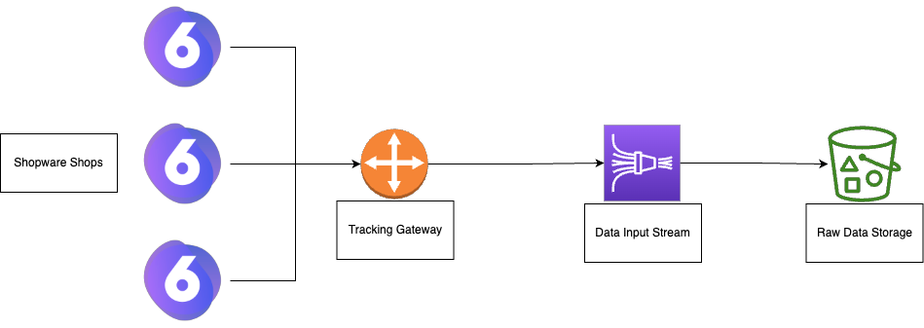
Task 1: Q 1: Challenges and Risks in Current Architecture
Scalability
Data Ingestion delays
Data Security & Privacy
Cost Management
Integration with other systems
Data Loss
Latency
API Gateway Limits
Data Integrity
Security Concerns
Data Retention & Backup
Reference link: Task document

Slide 6

Task 1: Q 2: Advantages & Disadvantages of Ecom Behavioral AWS architecture
Advantages
Unified Platform
Seamless AWS integration
centralized support
Scalability
Auto-scaling
high throughput for e-commerce needs
Reliable ML Features
Feature reuse
Transparent data lineage.
Data Quality
Automated cleaning
centralized metadata.
Security
Inherent AWS encryption
VPCs and compliance alignment.
Disadvantages
Complexity
Multi-service management
steep learning curve
Costs
Pay-as-you-go model
potential hidden charges
Lock-In
High AWS dependency
potential migration challenges
Latency
Data passing through multi-service chains.
Data Transfer Fees
Costs associated with data egress.
Reference link: AWS Data pipeline architecture

Slide 7
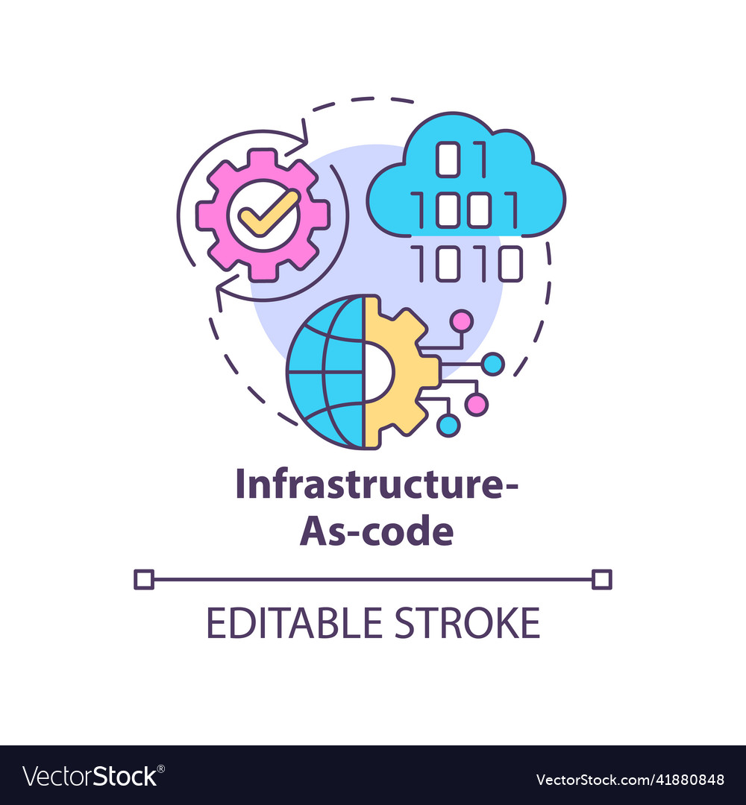
Task 2: Q 1 : Importance of Infrastructure-as-Code (IaC)
Consistency
Reproducible infrastructure setups
Reduce discrepancies.
Automation
Speedy deployments
Reduced manual interventions.
Version Control
Track changes, revert, and audit infrastructure changes.
Cost Efficiency
Optimize resources
Reduce wastage and human errors.
Scalability
Easily replicate configurations across different environments or regions.

Slide 8
Tools for IaC on AWS
AWS CloudFormation
AWS-native
Uses JSON or YAML templates to define the infrastructure
Terraform
Open-source
Uses HashiCorp Configuration Language (HCL); multi-cloud compatibility
AWS CDK (Cloud Development Kit)
Uses familiar programming languages like TypeScript, Python
Constructs to create cloud resources
Difference in a Nutshell
CloudFormation
AWS-focused
Template-driven
Terraform
Cloud-agnostic
state management
modular
AWS CDK
Developer-centric
Uses traditional programming for infrastructure

Slide 9
Task 2: Q 2: Terraform Implementation of the Solution
GitHub Repository: Link: ecom-aws-infrastructure
Using Terraform allows us to version control our infrastructure, making it reproducible and consistent across different environments.
Modules: Modular design for AWS services.
Environments: Config separation for different stages.
Main Files: Infrastructure blueprint in main.tf

Slide 10
Task 2: Q 3: Environment Management in Terraform
Objective
Efficiently handle dev, staging and production infrastructure setups without redundant code.
Terraform Modules
Abstract and encapsulate reusable parts of the infrastructure.
Environment-Specific Variable Files
Store unique configurations for each environment.
Directory Structure
Separate folders for each environment (e.g., environments/staging and environments/production).
Execution
Deploy with tailored config:
terraform apply -var-file=environments/staging.tfvars

Slide 11

Thank you

